Slide 1

FINNISH HEALTH DATA HACKATHON
Introductory Webinar
December 10, 2025
Notes:
Remember the recording!

Slide 2







Slide 3
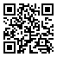
AGENDA
What Is a Hackathon?
Nordic Health Data Hackathon Series
Finnish Health Data Hackathon
When & where
Tracks
Participation
Series of info webinars
fhir.fi/hackathon

Slide 4
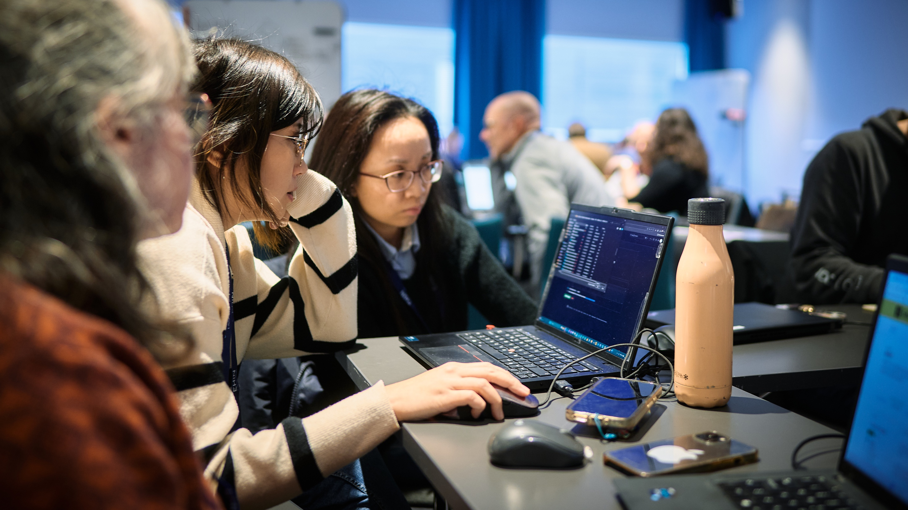
©️ Still Words Photography clients.stillwords.com/EHiN2025
Notes:
Essentially, developers coming together and coding stuff.
Connect your systems and see how they talk to each other.

Slide 5
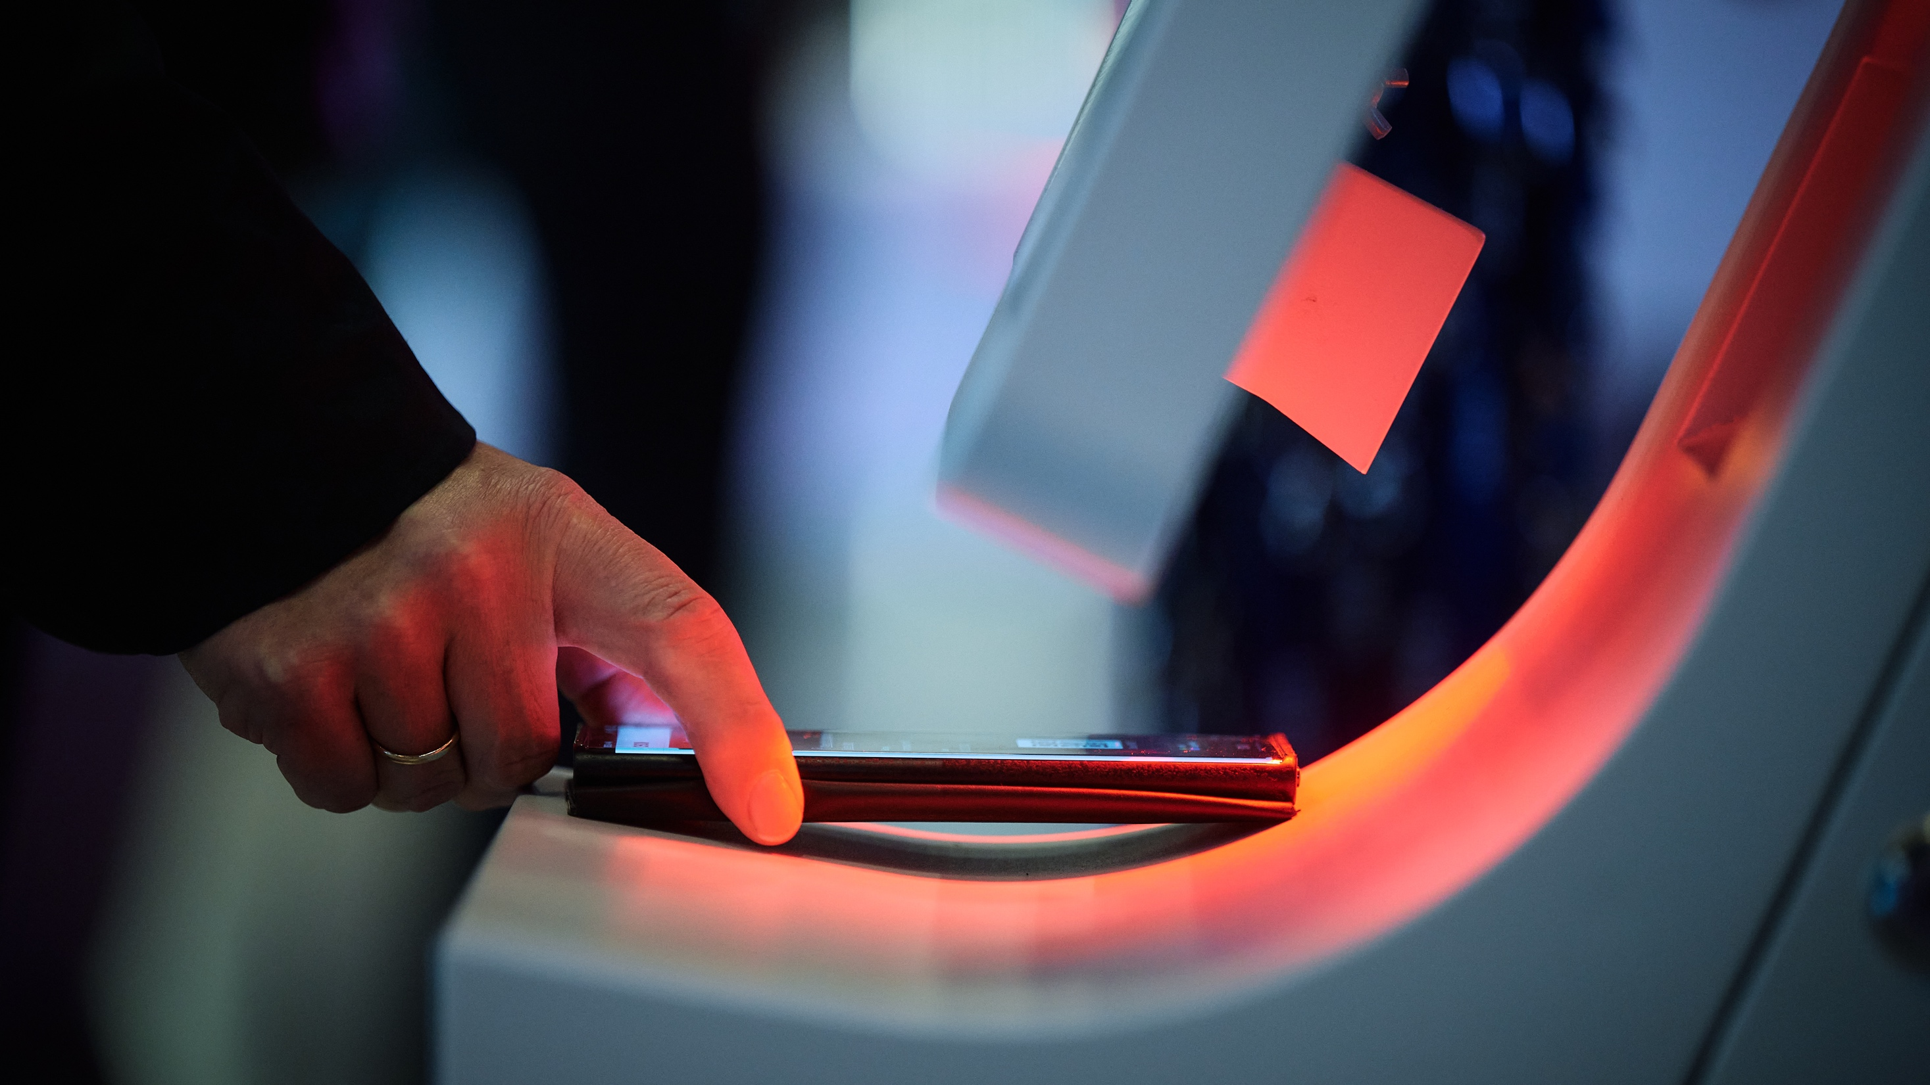
©️ Still Words Photography clients.stillwords.com/EHiN2025
Notes:
You need some way of getting people involved.
Register beforehand, discuss what’s possible.
This webinar is part of that activity.

Slide 6
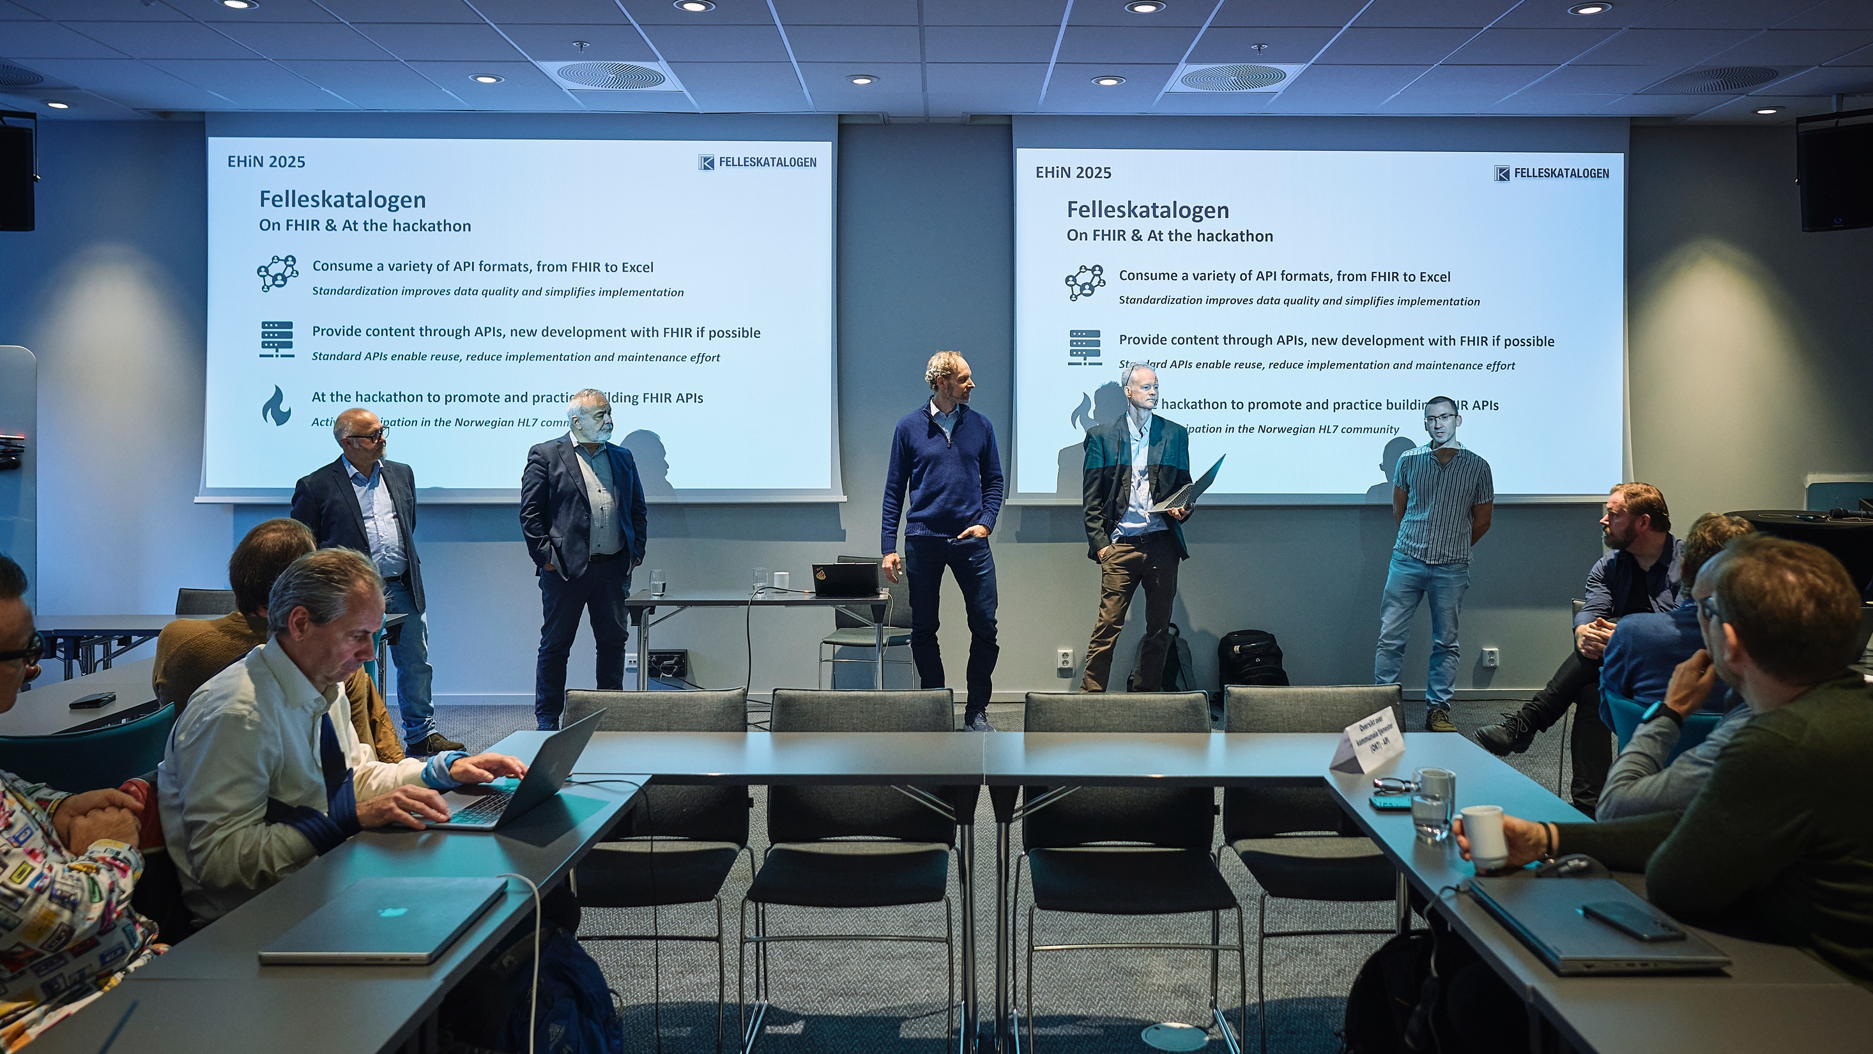
©️ Still Words Photography clients.stillwords.com/EHiN2025
Notes:
Need track leads. Not so much involved in hacking, rather coordinating and helping others.
Might still be the best experts, and the ones who solve the trickiest questions.

Slide 7
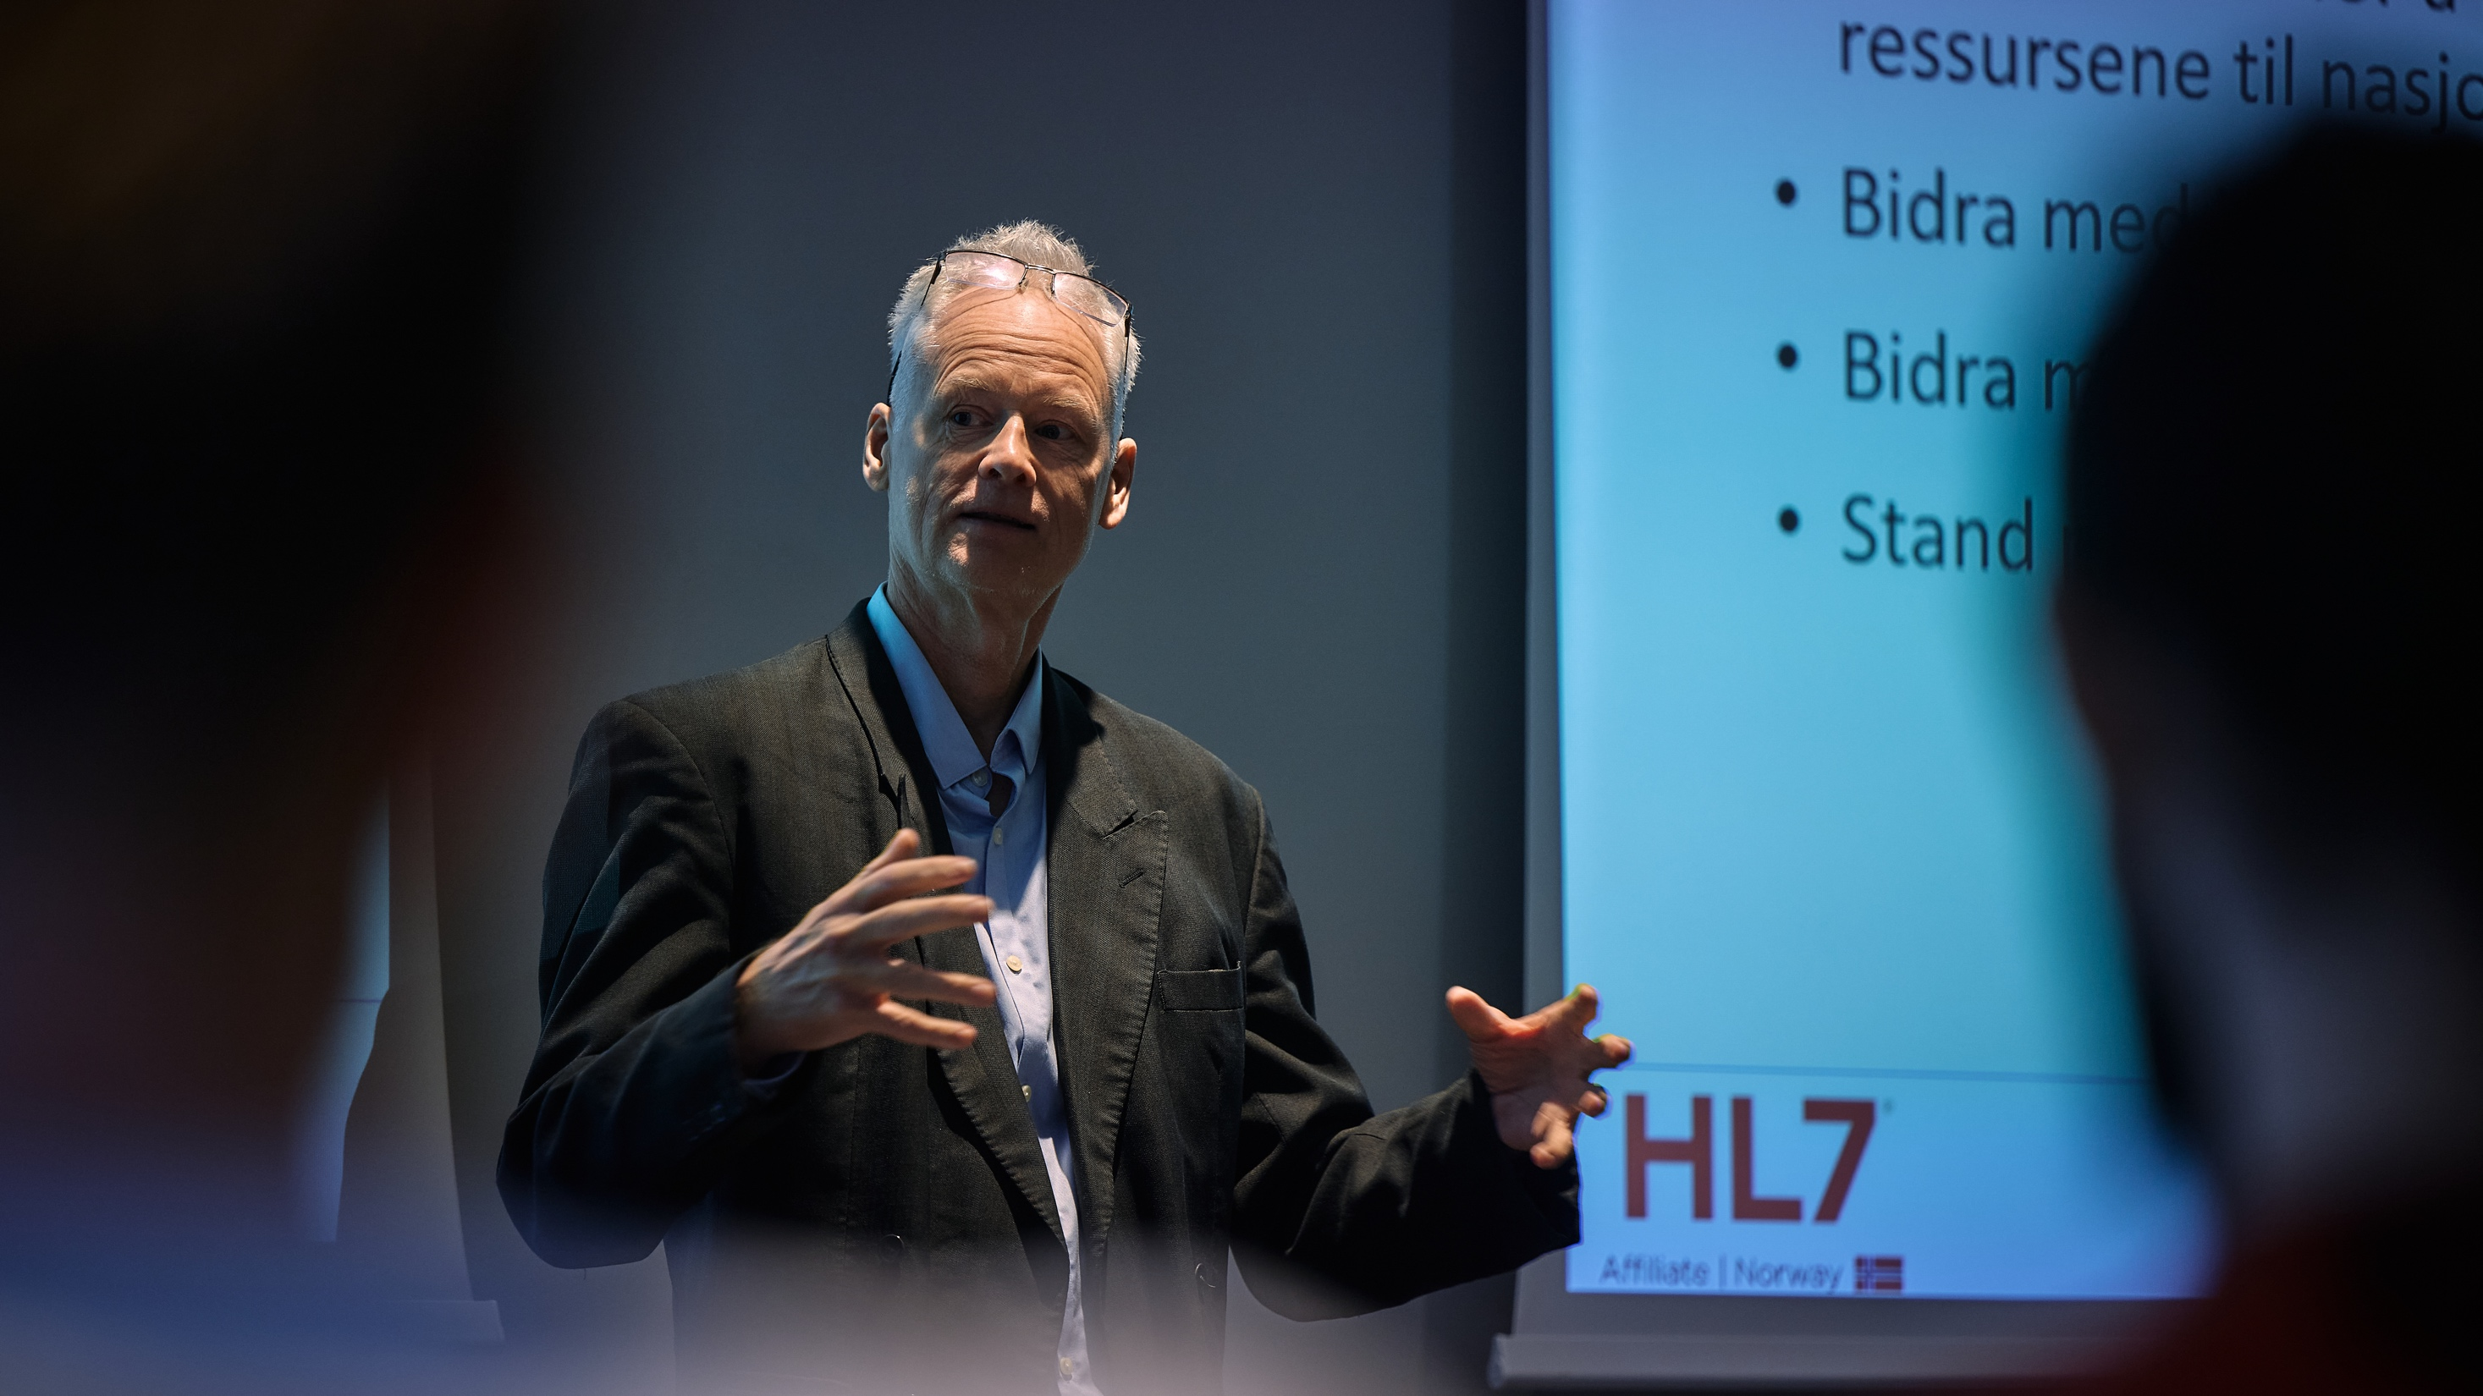
©️ Still Words Photography clients.stillwords.com/EHiN2025
Notes:
A chance for spec authors to both advertise and explain their specification.
What it is for, how you get started with it.
Why you should care.
Hackathons often have some educational content.

Slide 8
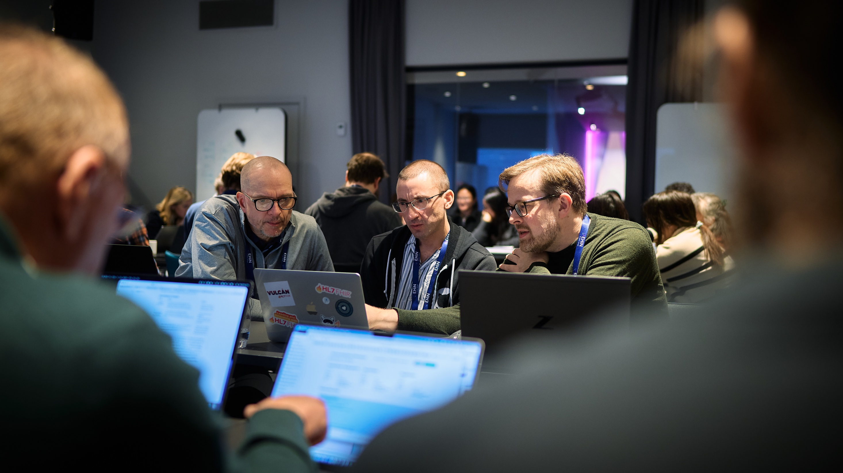
©️ Still Words Photography clients.stillwords.com/EHiN2025
Notes:
When there’s a glitch, resolve it fast, as you have the right people there.

Slide 9

©️ Still Words Photography clients.stillwords.com/EHiN2025
Notes:
Discuss about the specifications. This is how I interpret it, and why.
Give feedback – it is possible to interpret this part in this and this way.
It’s possible to implement this part in this and that way.
Specs always aim to be clear and unambiguous. It’s hard.

Slide 10
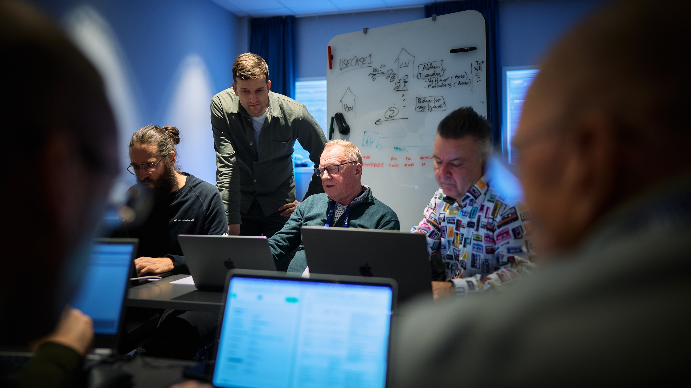
©️ Still Words Photography clients.stillwords.com/EHiN2025
Notes:
Vendors get feedback on their API specifications and implementations.
Also learn of new use cases and existing implementations.

Slide 11
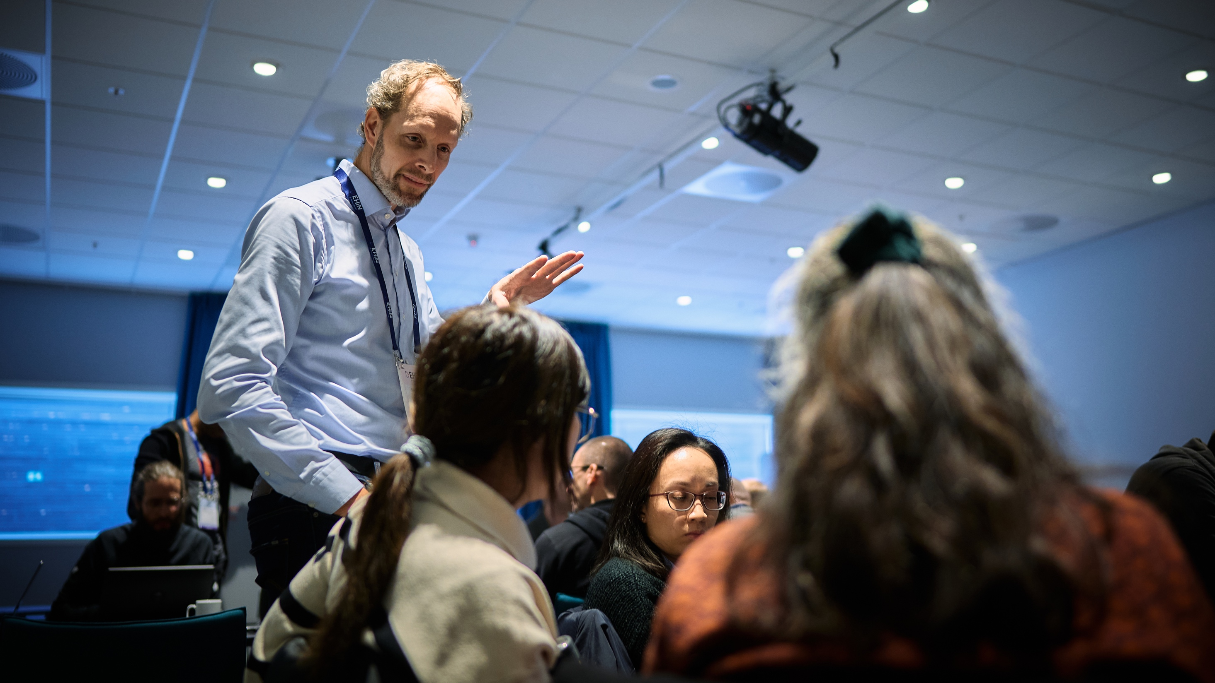
©️ Still Words Photography clients.stillwords.com/EHiN2025
Notes:
Reach out to stakeholders.

Slide 12
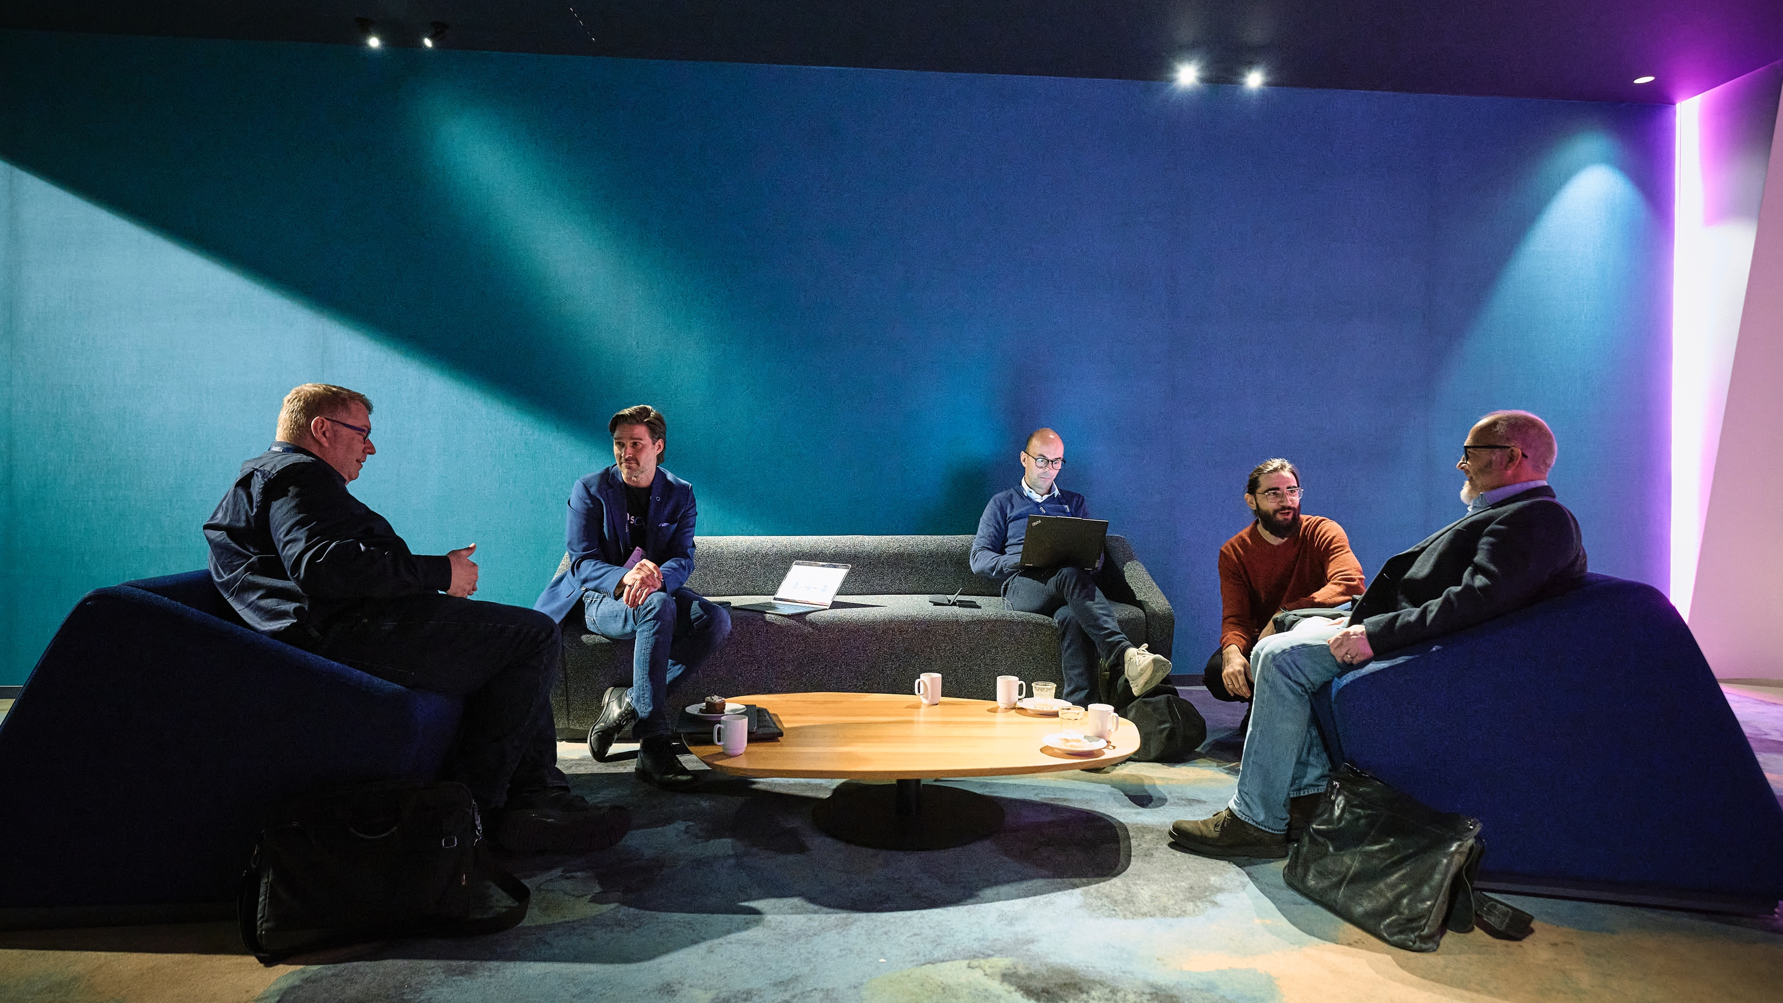
©️ Still Words Photography clients.stillwords.com/EHiN2025
Notes:
Optimally, the hackathon leads to meaningful discussions and bringing the integrations into production.
Hackathons are for technical people.
Don’t send your sales guy to do a pitch or to sign a deal.

Slide 13
Q&A
Hackathons

Slide 14
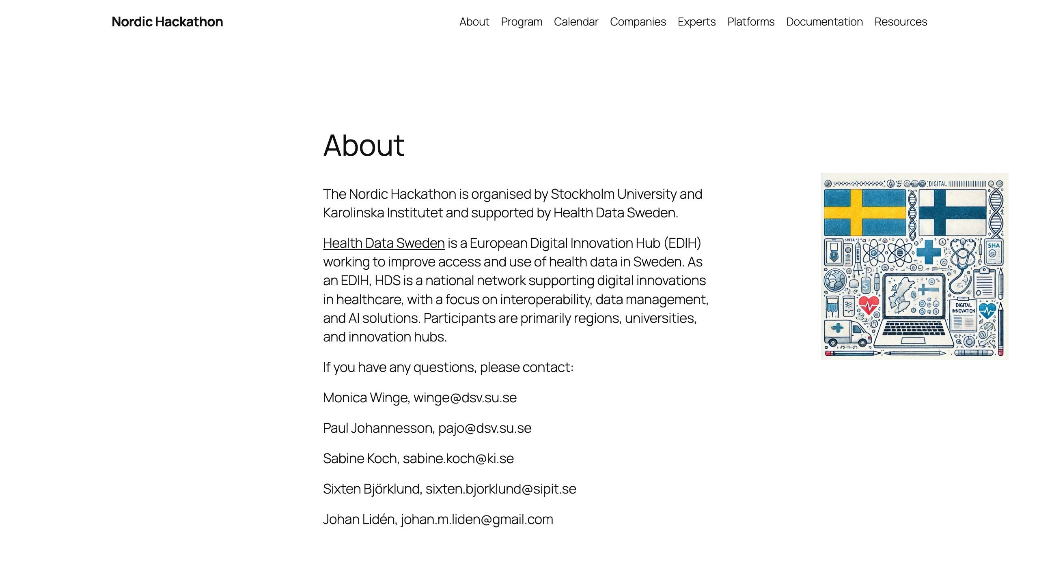
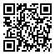
nordichackathon-blogs-dsv-su-se.svg

Slide 15

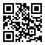
fhir.fi/hackathon

Slide 16
Nordic Health Data Hackathons
Norway, EHiN
Finland, Radical Health Festival
Sweden, Vitalis
Denmark, autumn

Slide 17
Nordic Health Data Hackathons 2025-2026
Norway, EHiN
Pasientens måledata (PMD) FHIR API
Make a FHIR version of the OKT API
Nordic tx FHIR server API
FHIR IG authoring and building
Finland, Radical Health Festival
Patient Access to Health Data
Care Plans, Clinical Decision Support, and Computable Care Guidelines
Sweden, Vitalis
FHIR Base Profiles, National & EU
Terminology
Denmark, autumn
Patient summaries?
EHDS priority categories?

Slide 18
FINNISH HEALTH DATA HACKATHON
January 19-21, Helsinki, Finland

Slide 19
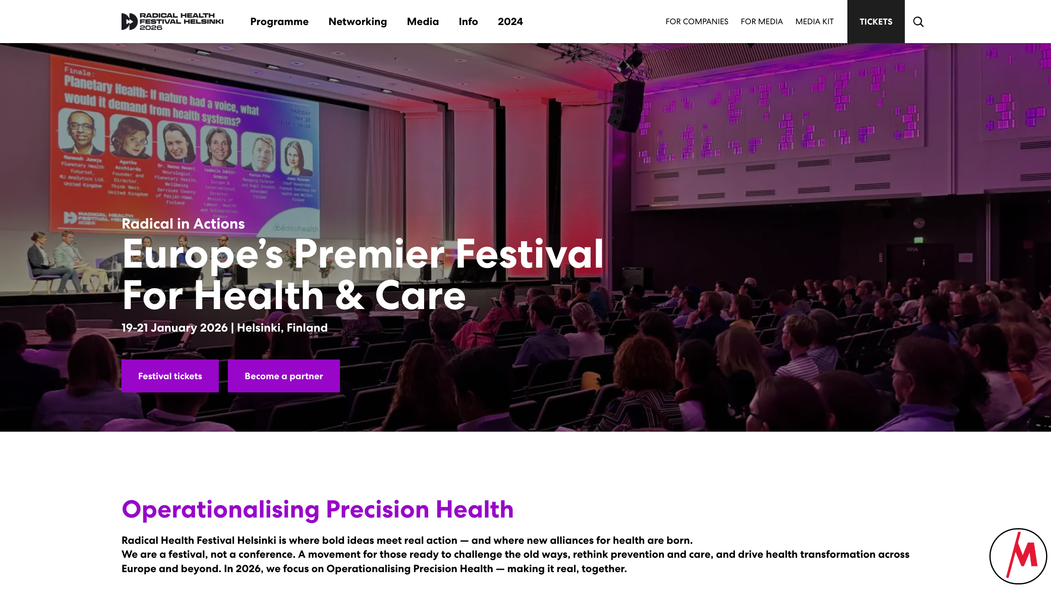
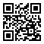
radicalhealthfest.com

Slide 20
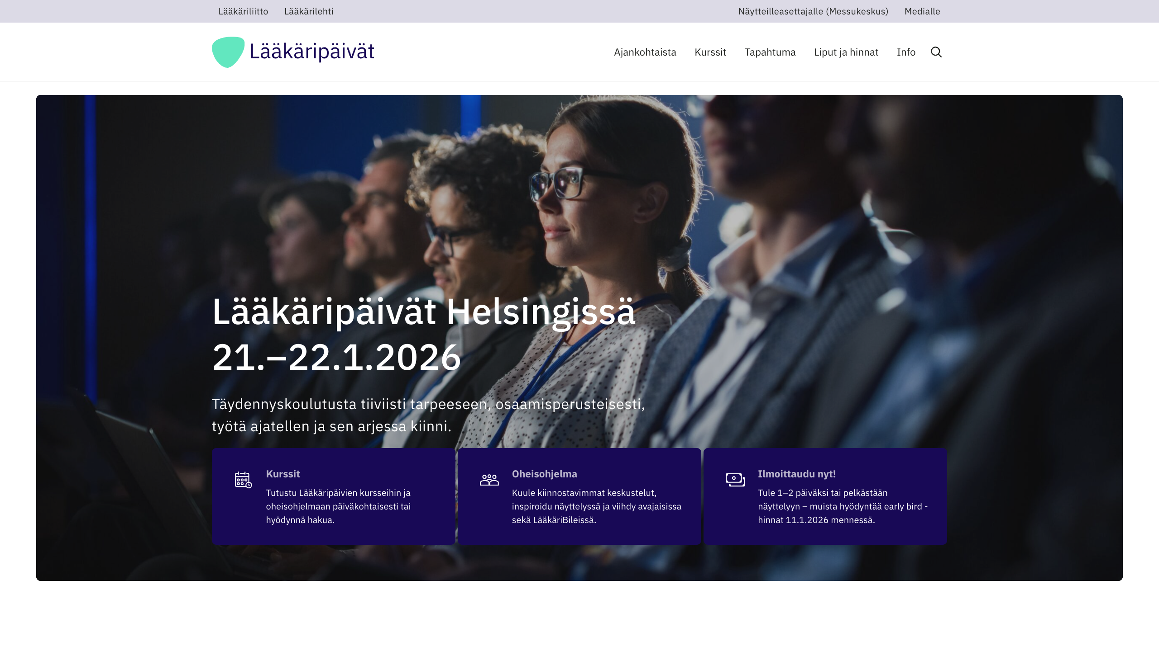
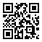
laakaripaivat.fi

Slide 21
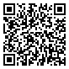
HL7 Finland 30 Years Symposium
Monday, 19 January 2026
Same premises as the hackathon
Requires different registration!
Draft agenda:
9.30-10.00 Coffee 10.00-12.00 Finnish sessions 12.00-13.00 Lunch 13.00-16.00 International sessions 16.00- Networking and drinks
www.hl7.fi/kokoukset-ja-tapahtumat/hl7-finland-30th-anniversary-symposium/

Slide 22
Track: Patient Access to Health Data
Finnish SMART App Launch
City of Helsinki / Apotti / Epic
Kanta
xShare Yellow Button
Health Data and Identity Wallets
Separate webinar on Monday, December 15, 17:00 CET
Another webinar for Apotti / Epic, on December 15 or 16
Third webinar on identity wallets and NCP’s, December 19, 11:00 CET

Slide 23
Track: Care Plans, Clinical Decision Support, and Computable Care Guidelines
Separate webinar coming up!

Slide 24
When & Where
Monday, January 19, 2026, starting at 9:00 EEST
Kuntatalo
Some tracks continue on Tuesday, January 20, 2026
Messukeskus
Results presented on Wednesday, January 21, 2026
Messukeskus

Slide 25
Participation
Register in advance
No costs involved!
Notes:
for the main hackathon on Monday
Radical Health Festival and Lääkäripäivät require a paid registration

Slide 26
Sponsors

Slide 27
Q&A
Finnish Health Data Hackathon

Slide 28
Next Webinars
Patient Access Track
Monday, December 15, 17:00 CET
Apotti / Epic
Monday, Dec 15 / Tueday, Dec 16?
Wallets, national contact points (NCP)
Friday, December 19, 11:00 CET
Care Plans, Clinical Decision Support, Computable Care Guidelines
?

Slide 29
Thank you for participating!

